Slide 1
Analysis of Horn Antenna in C-band
Alireza Javid
Antenna Theory
University of Tehran

Slide 2
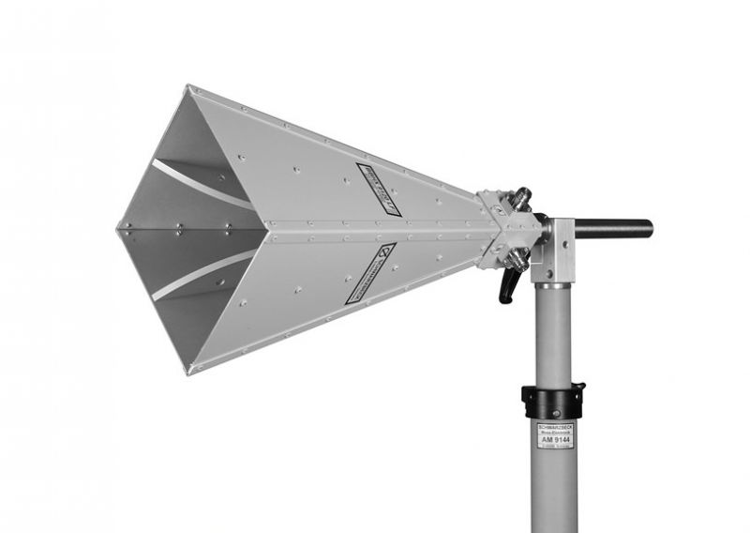
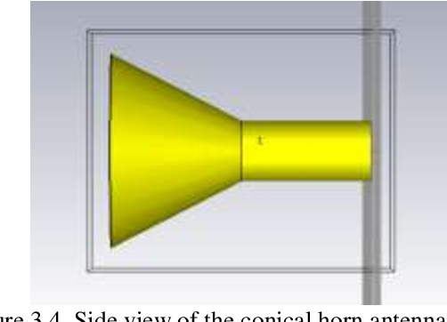
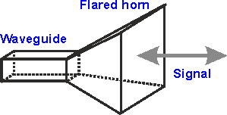
Introduction to Horn Antenna
A horn antenna is an antenna that uses a flaring metal waveguide shaped like a horn to direct radio waves in a beam.

Slide 3
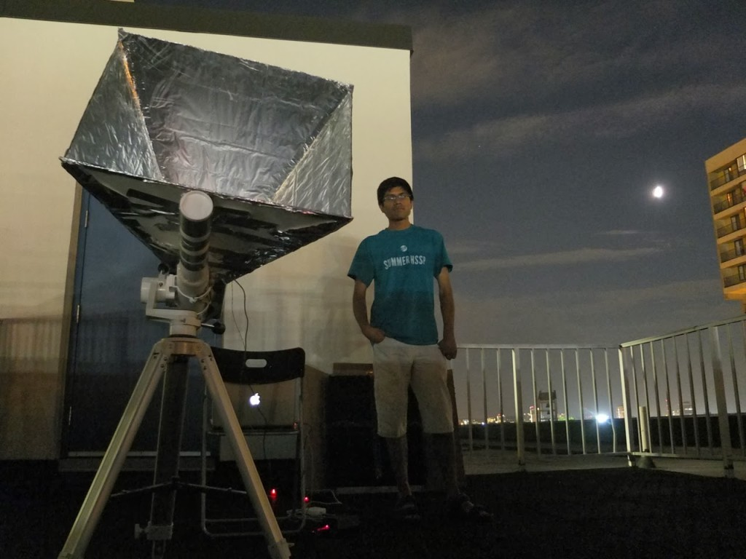
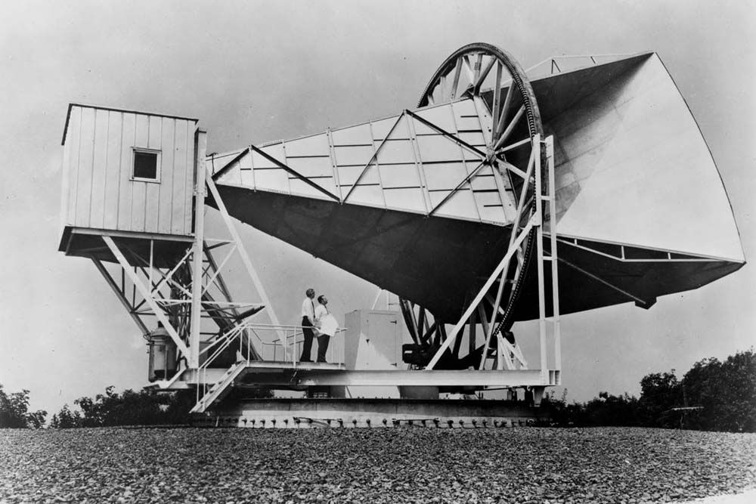
Introduction to Horn Antenna
Horn antennas are widely used for applications such as radio astronomy, satellite, and terrestrial communication, plasma diagnostics and more. They are used for moderate gains at microwave frequencies and can be used as a primary or feed element in a dish antenna. Horn antennas are also used for measurement of different antenna parameters in laboratories.

Slide 4
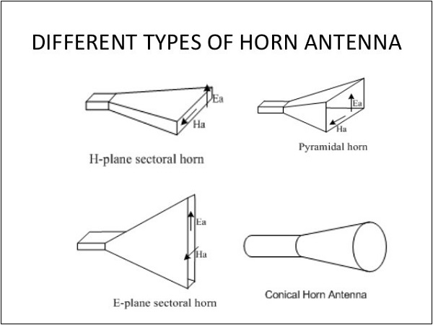
Introduction to Horn Antenna

Slide 5
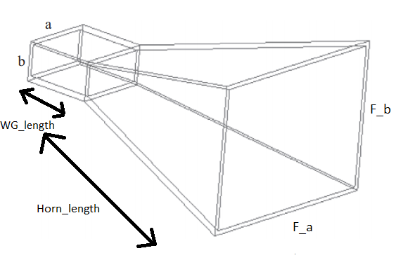
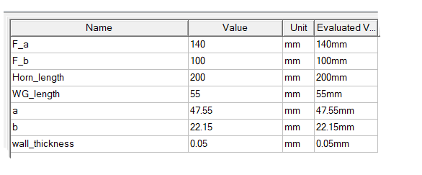
Design Parameters of Horn Antenna in C-band

Slide 6
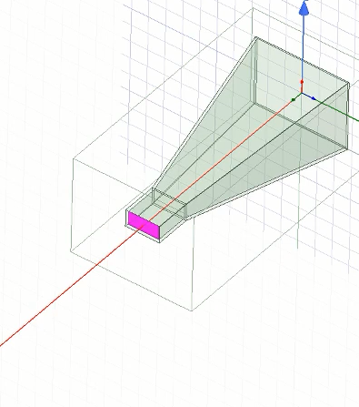
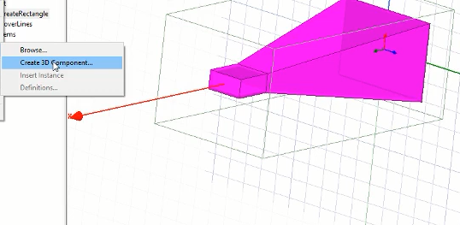
Design in HFSS
We have used wave port for excitation
We create a 3D model Component to use our design in
next parts

Slide 7
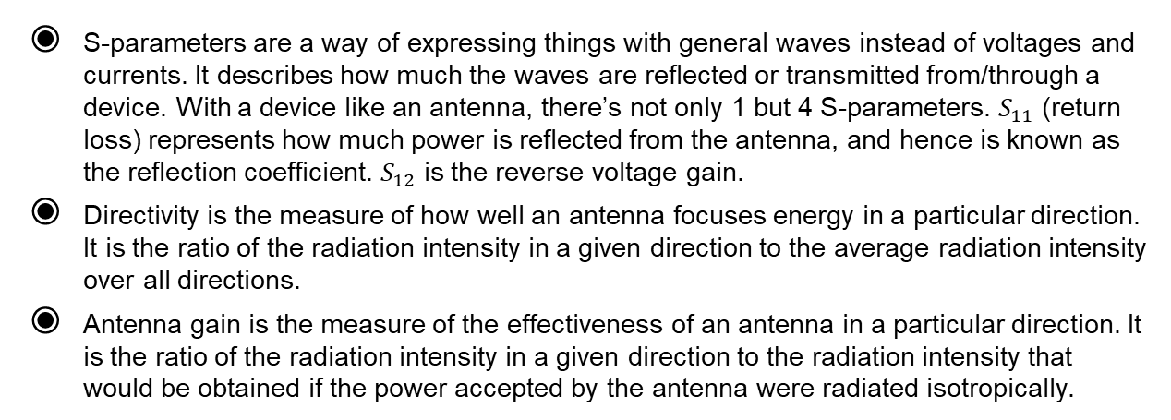
Analysis Parameters
S-parameters are a way of expressing things with general waves instead of voltages and currents. It describes how much the waves are reflected or transmitted from/through a device. With a device like an antenna, there’s not only 1 but 4 S-parameters. $S_{11}$ (return loss) represents how much power is reflected from the antenna, and hence is known as the reflection coefficient. $S_{12}$ is the reverse voltage gain.
Directivity is the measure of how well an antenna focuses energy in a particular direction. It is the ratio of the radiation intensity in a given direction to the average radiation intensity over all directions.
Antenna gain is the measure of the effectiveness of an antenna in a particular direction. It is the ratio of the radiation intensity in a given direction to the radiation intensity that would be obtained if the power accepted by the antenna were radiated isotropically.

Slide 8
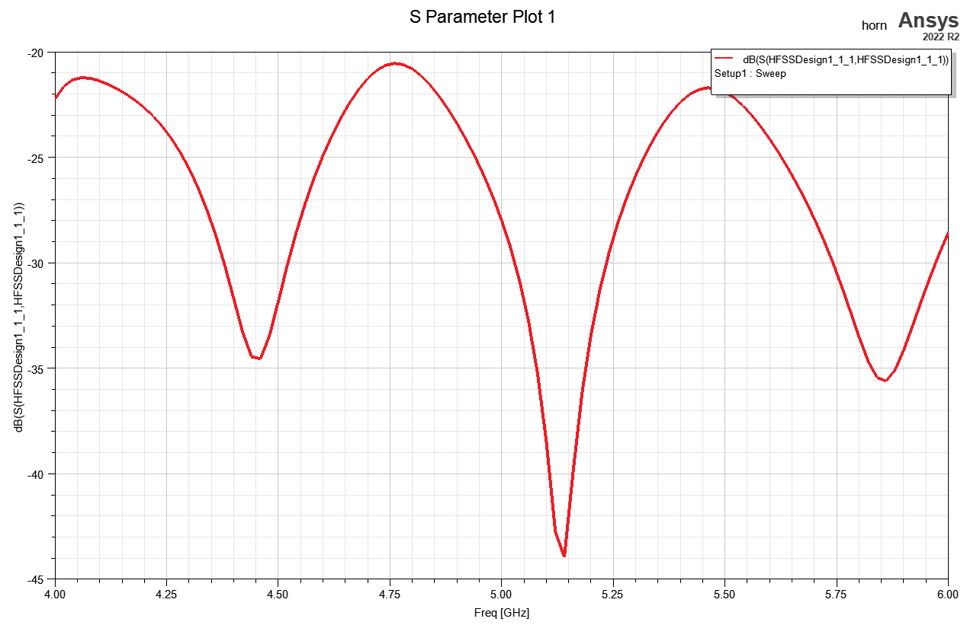
Analysis of a Horn Antenna

Slide 9
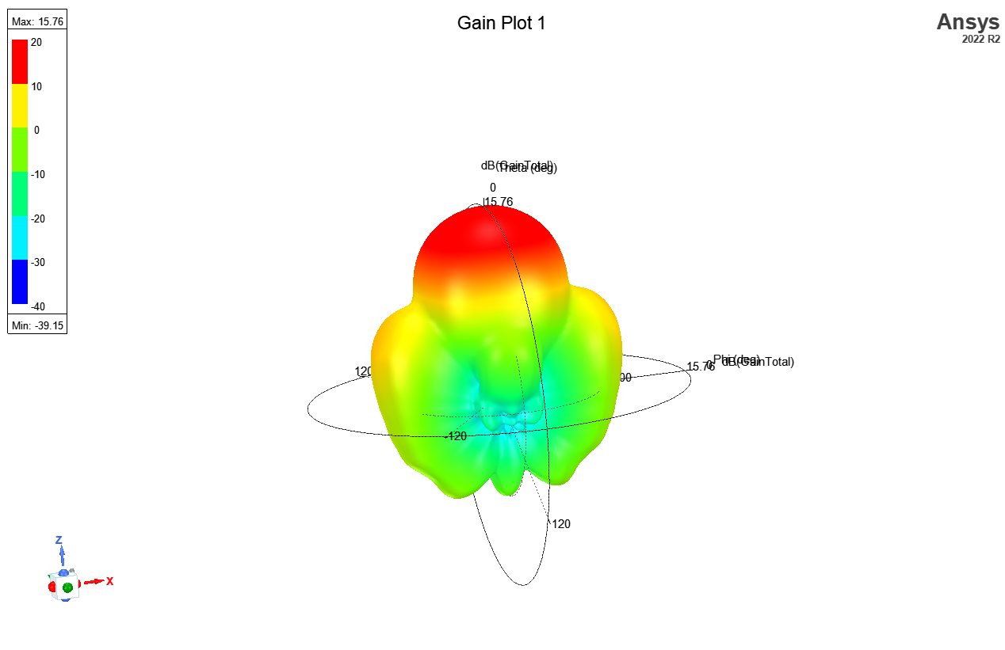
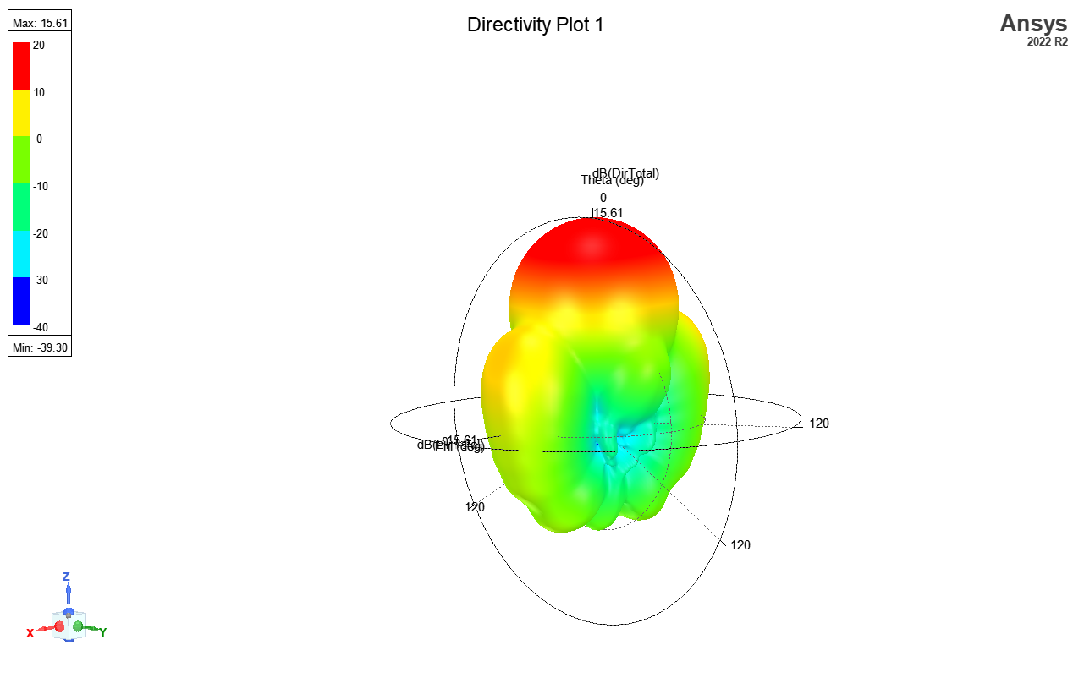
Analysis of a Horn Antenna

Slide 10
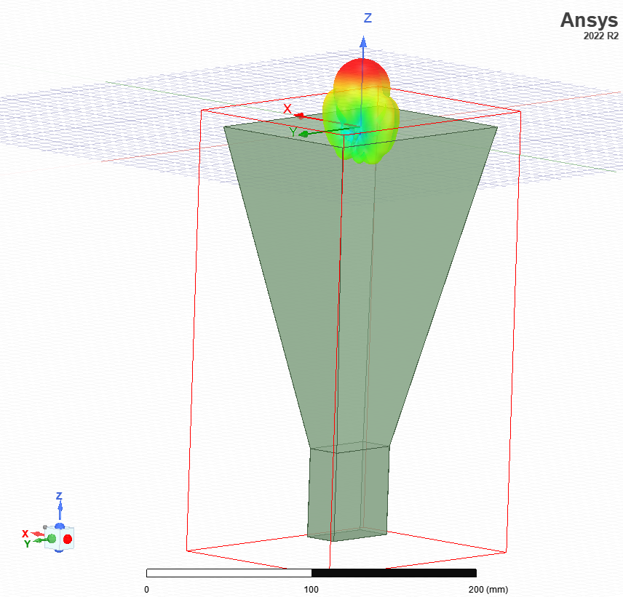
Analysis of a Horn Antenna

Slide 11
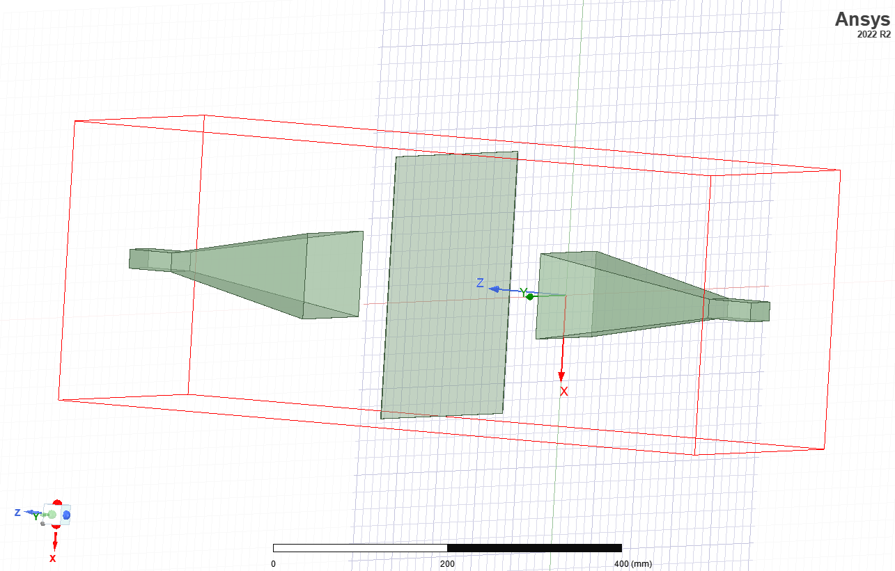
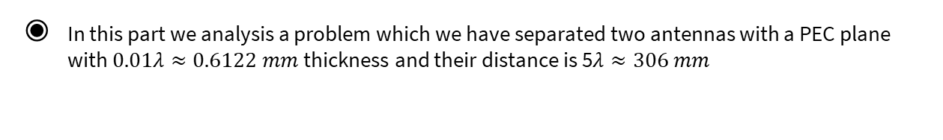
A PEC Plane Between 2 Horn Antennas
In this part we analysis a problem which we have separated two antennas with a PEC plane with $0.01λ≈0.6122 mm$ thickness and their distance is 5$λ≈306 mm$

Slide 12
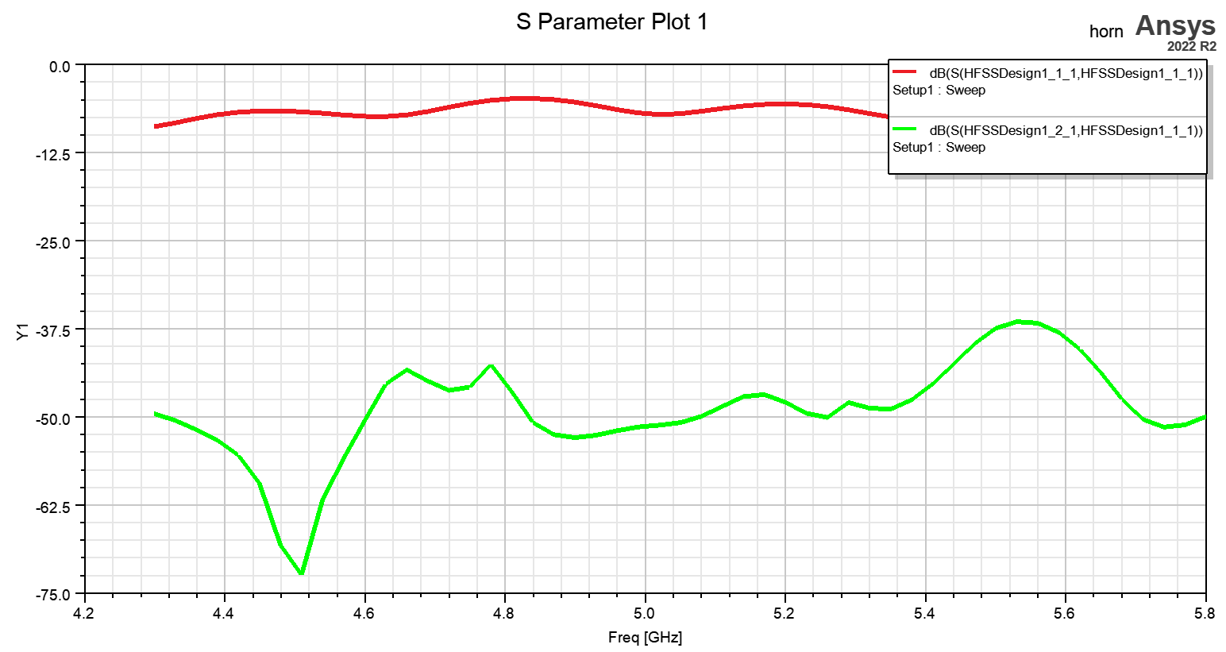
A PEC Plane Between 2 Horn Antennas

Slide 13
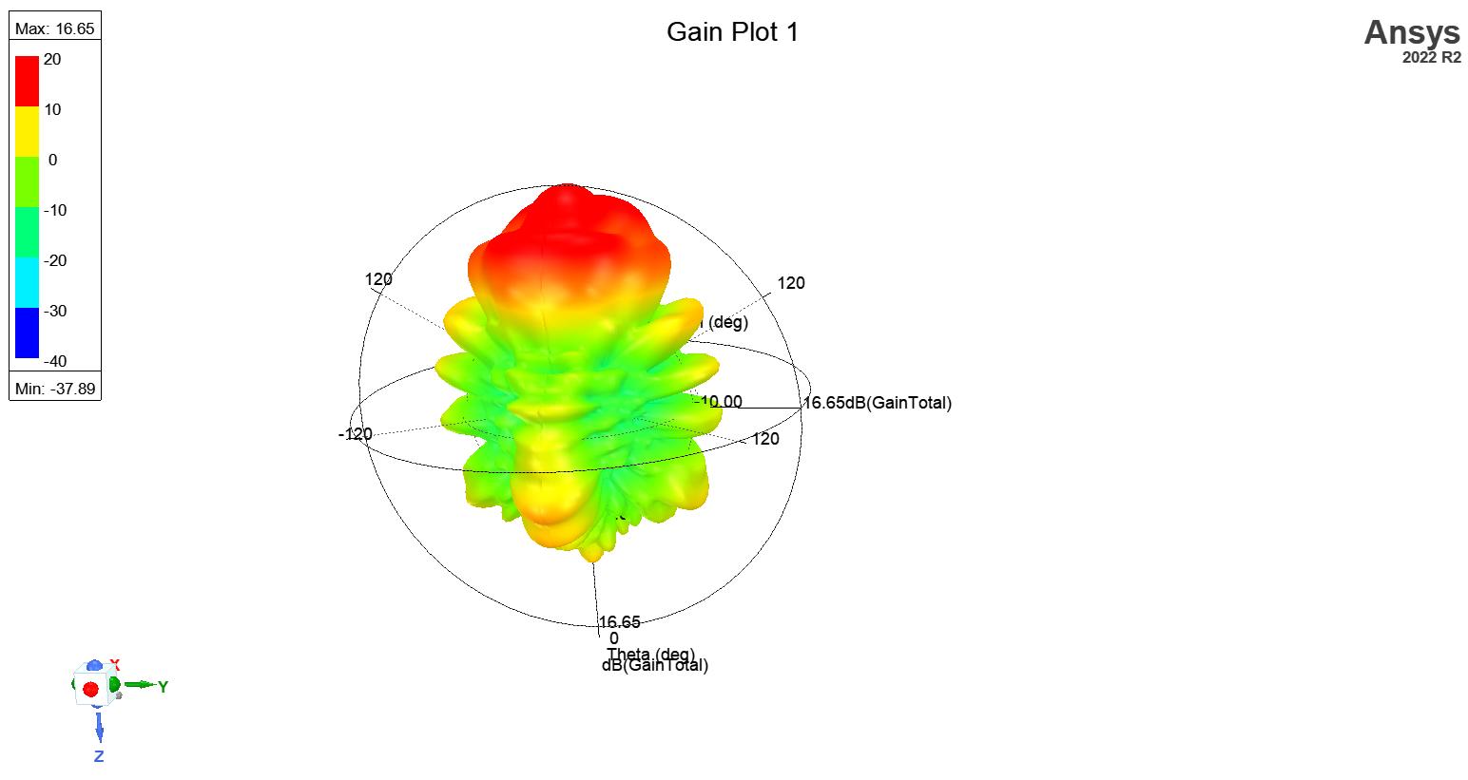
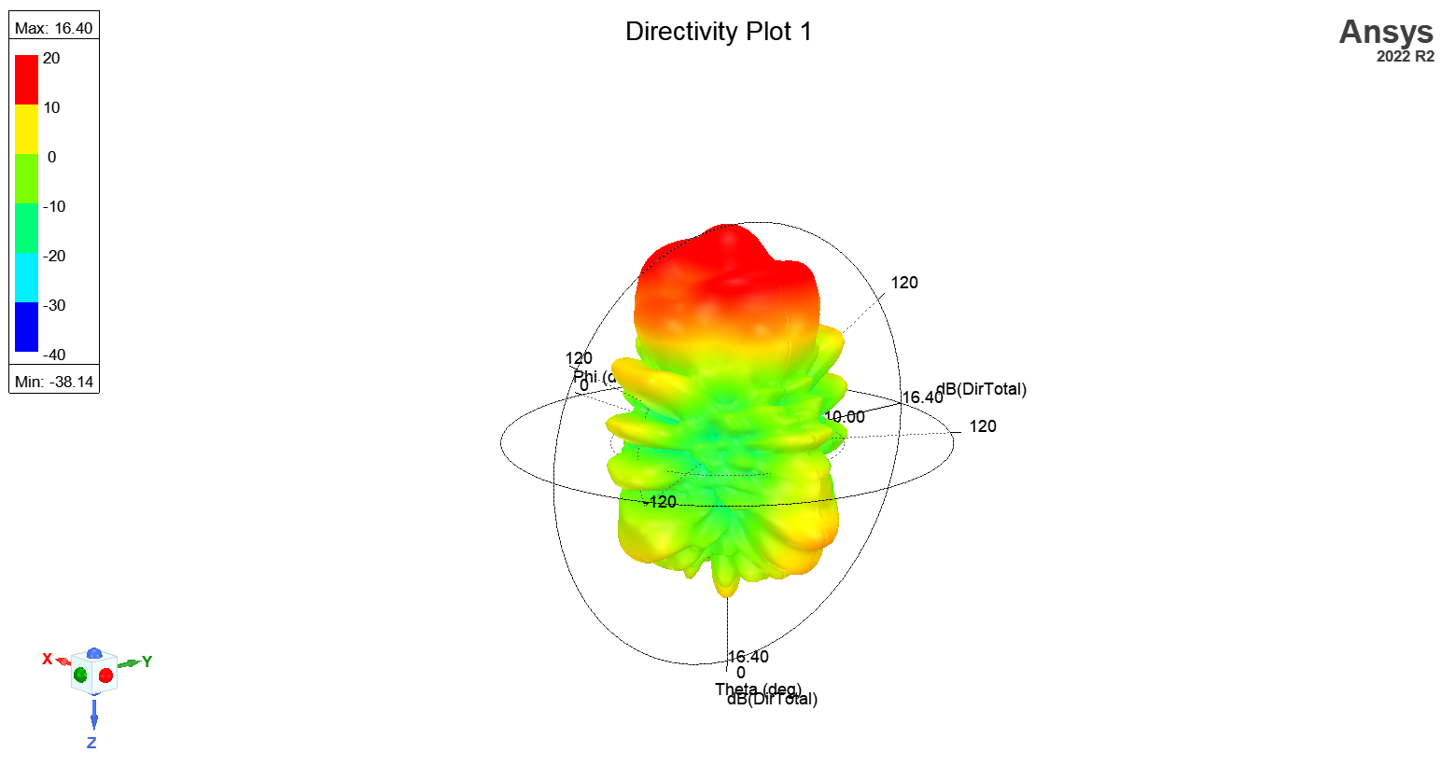
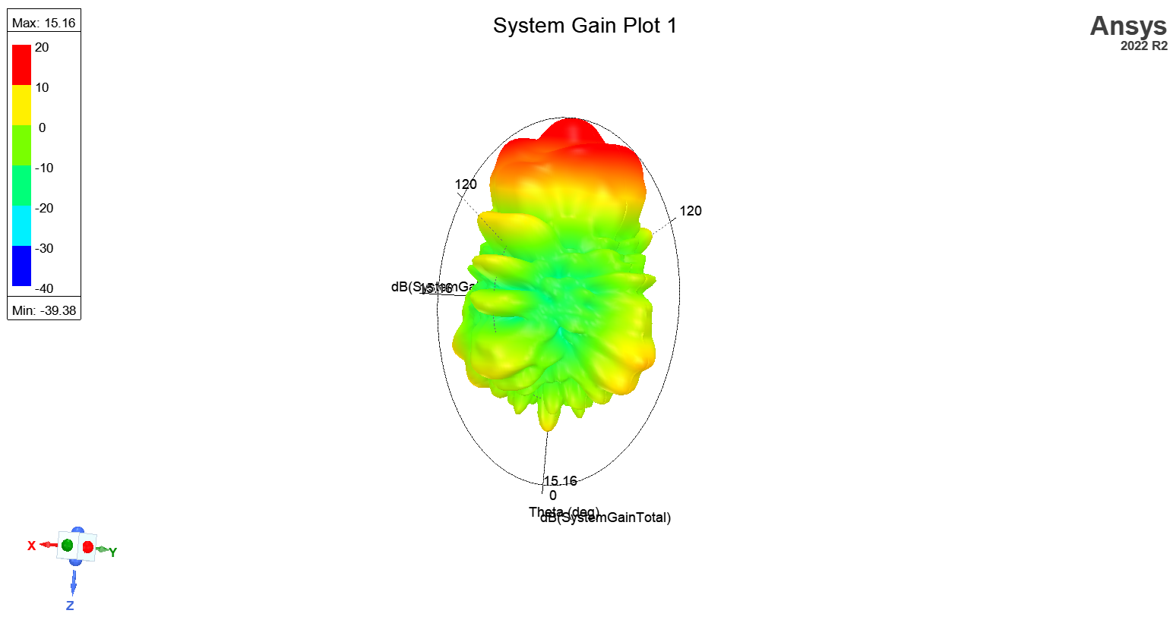
A PEC Plane Between 2 Horn Antennas

Slide 14
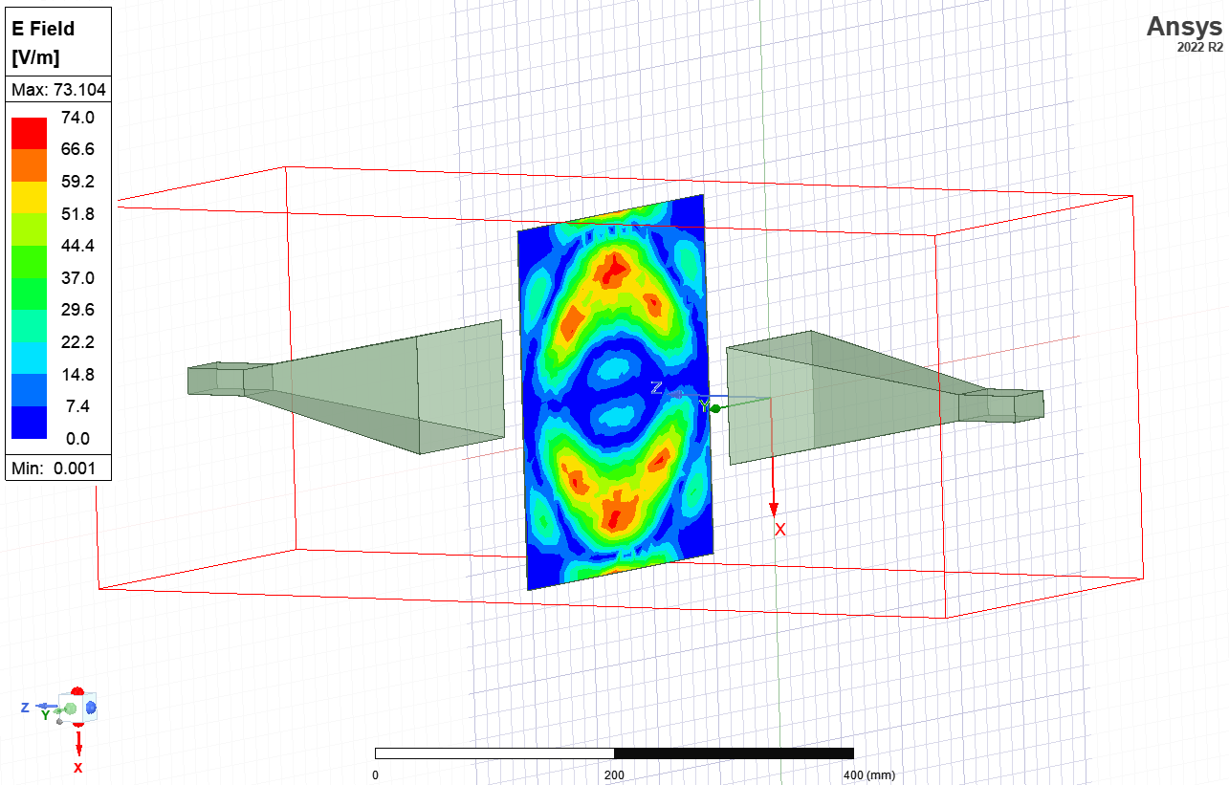
A PEC Plane Between 2 Horn Antennas

Slide 15
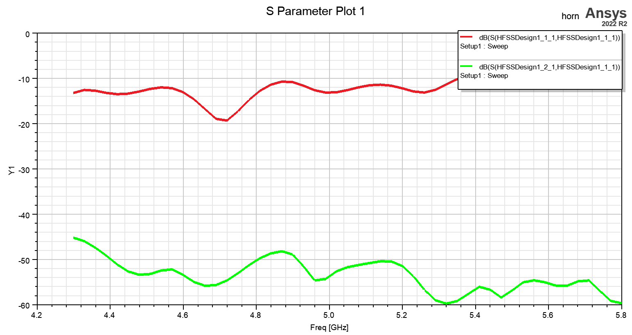

A PEC Plane Between 2 Horn Antennas
Now we increase their distance to 1$0λ≈612 mm$

Slide 16
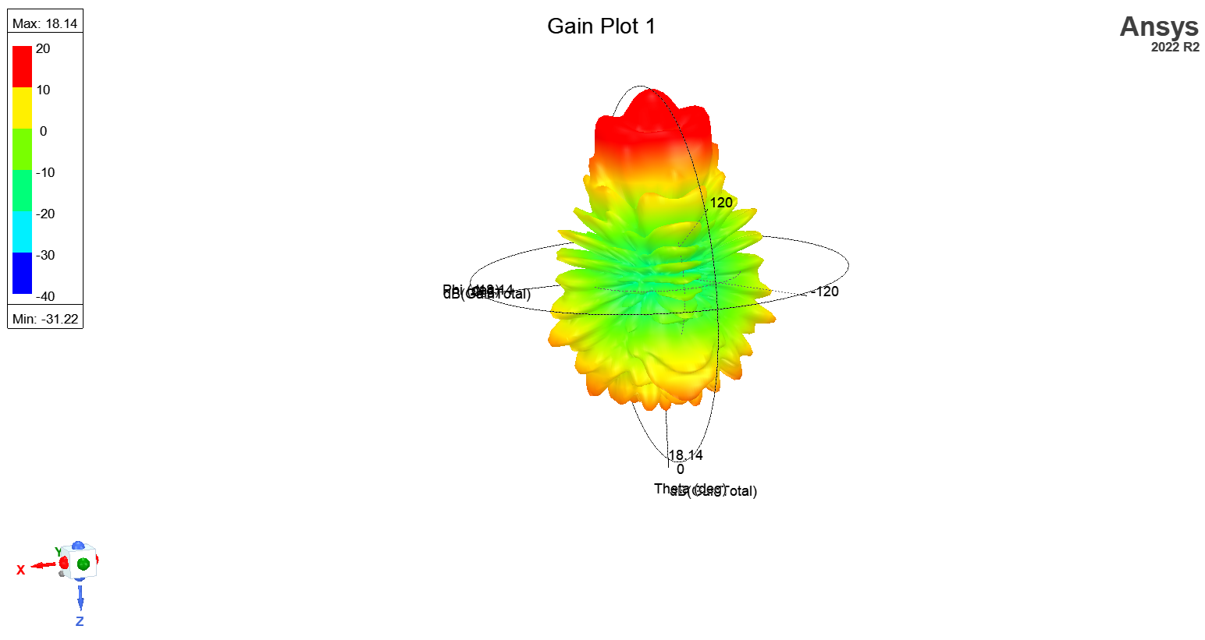
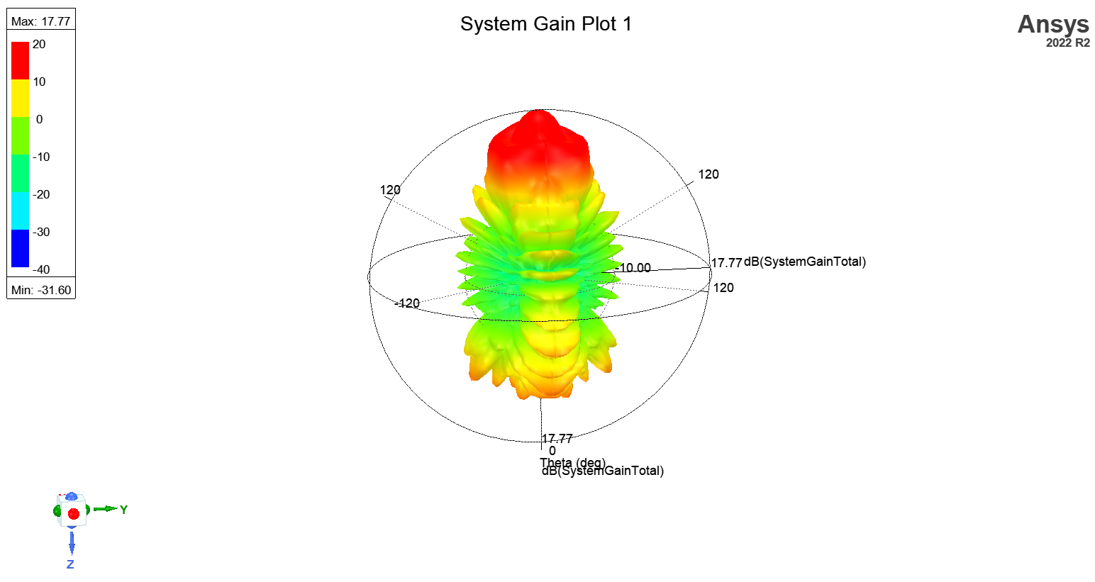
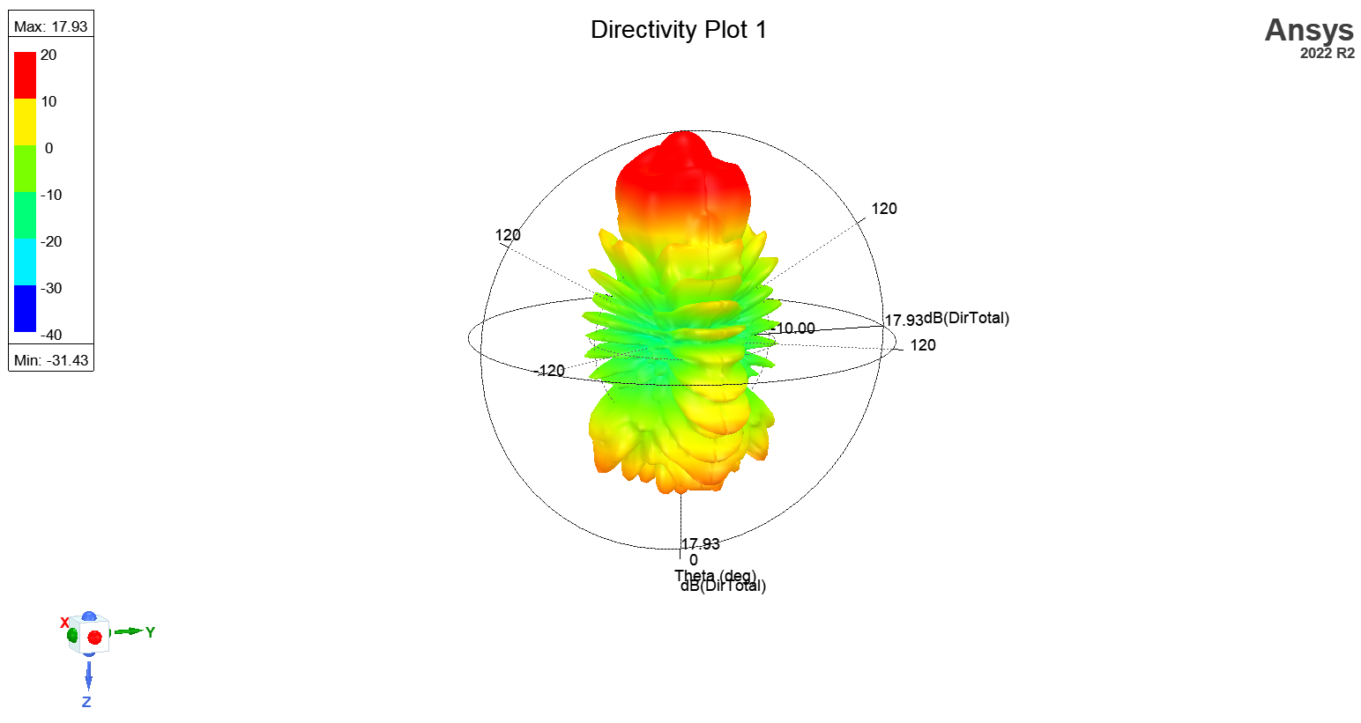
A PEC Plane Between 2 Horn Antennas

Slide 17
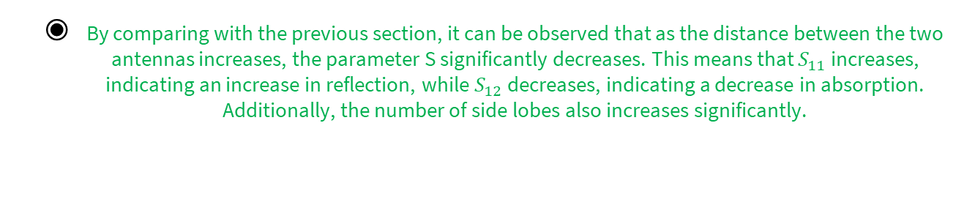
A PEC Plane Between 2 Horn Antennas
By comparing with the previous section, it can be observed that as the distance between the two antennas increases, the parameter S significantly decreases. This means that $S_{11}$ increases, indicating an increase in reflection, while $S_{12}$ decreases, indicating a decrease in absorption. Additionally, the number of side lobes also increases significantly.

Slide 18
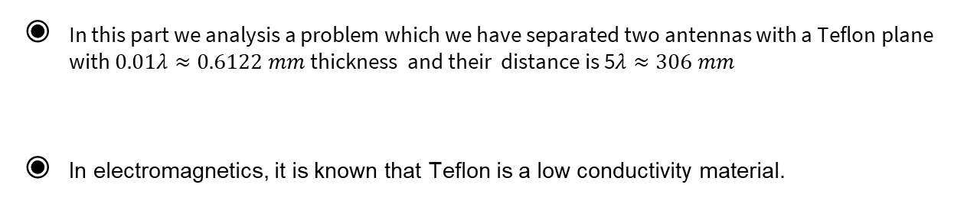
A Teflon Plane Between 2 Horn Antennas
In this part we analysis a problem which we have separated two antennas with a Teflon plane with $0.01λ≈0.6122 mm$ thickness and their distance is 5$λ≈306 mm$
In electromagnetics, it is known that Teflon is a low conductivity material.

Slide 19
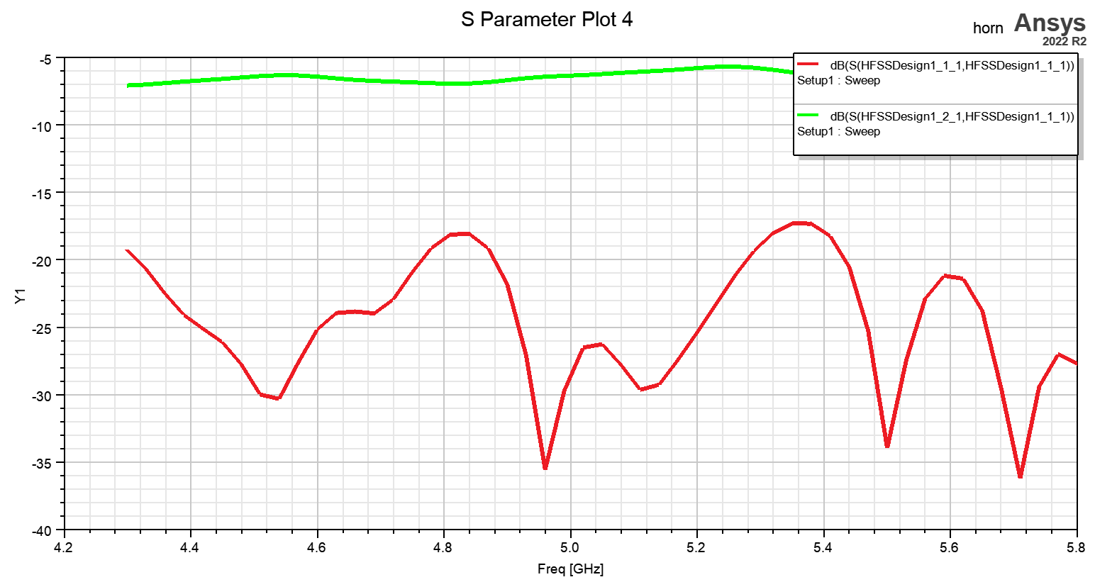
A Teflon Plane Between 2 Horn Antennas

Slide 20
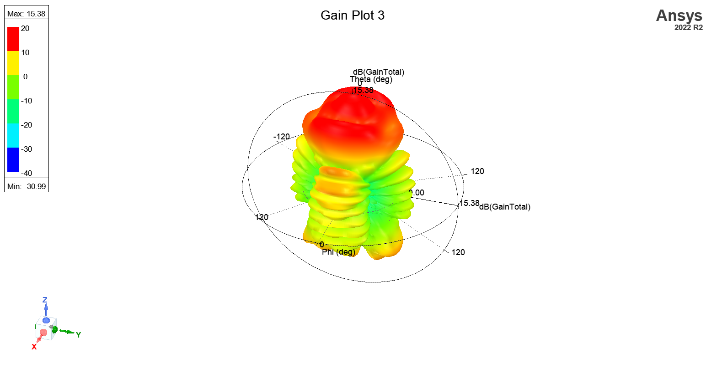
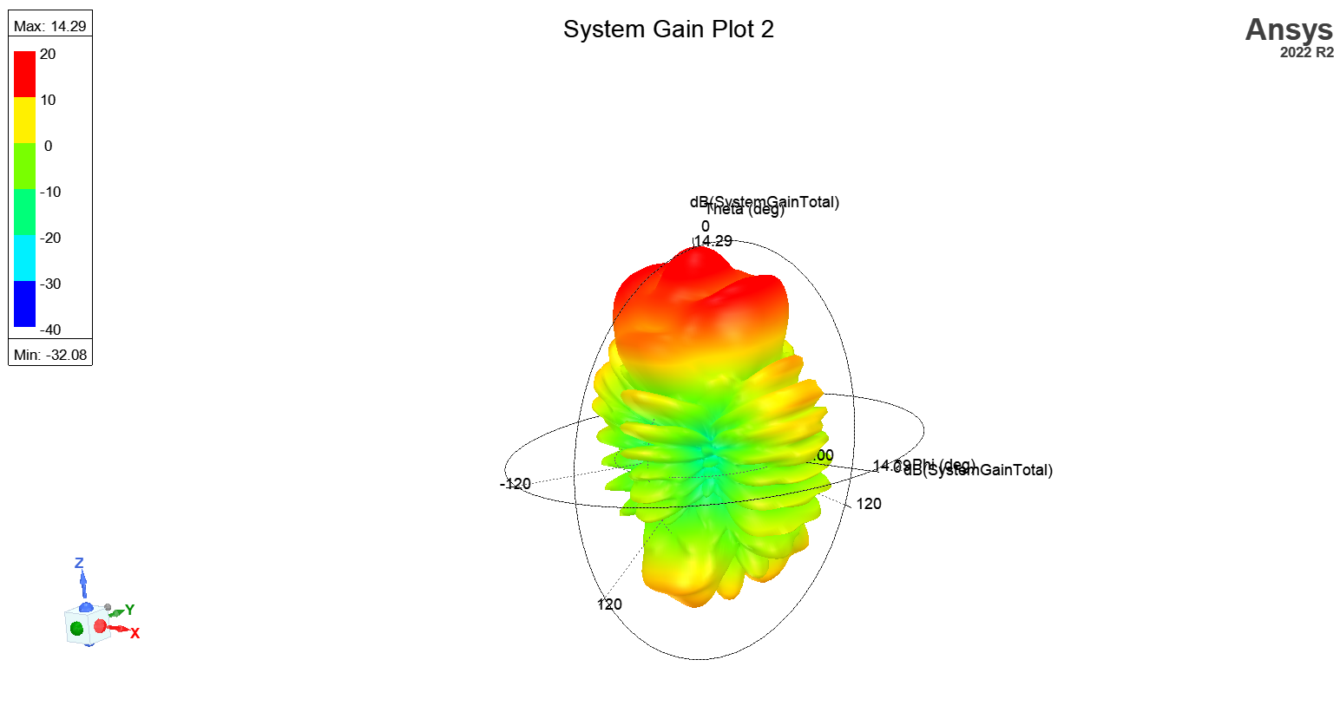
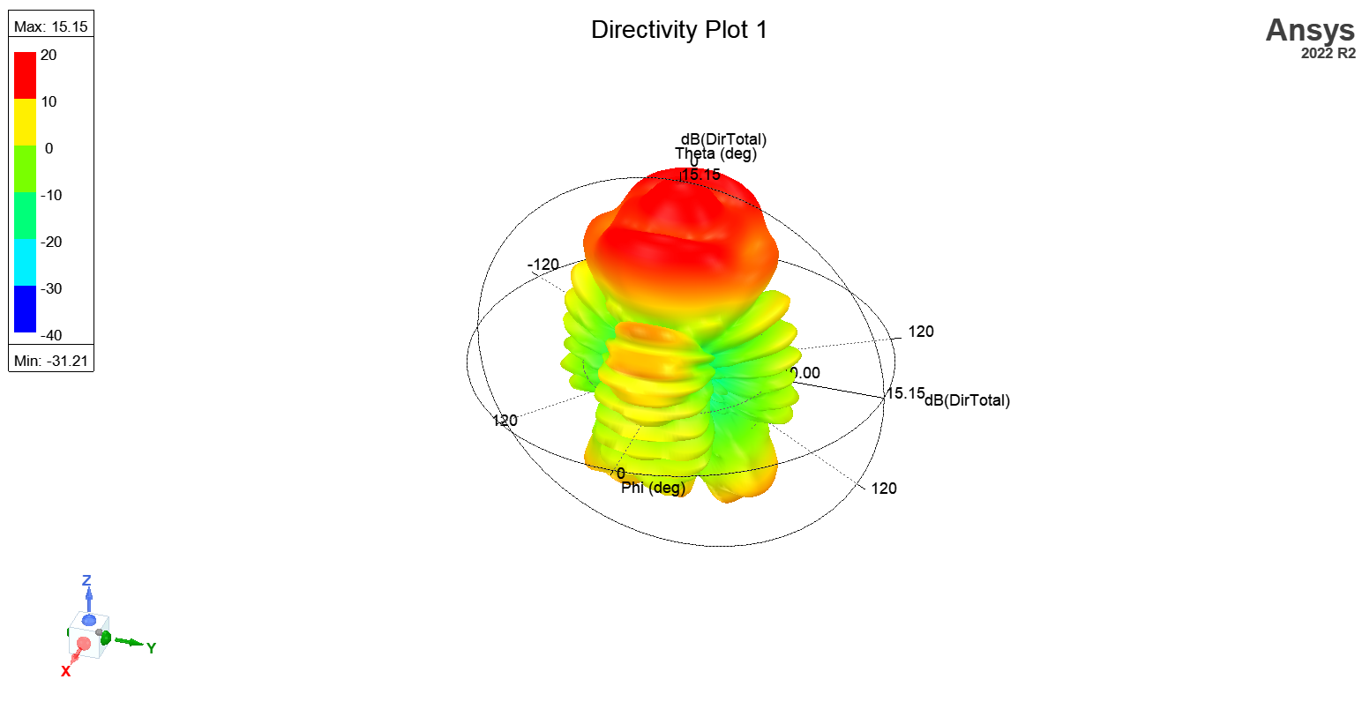
A Teflon Plane Between 2 Horn Antennas

Slide 21
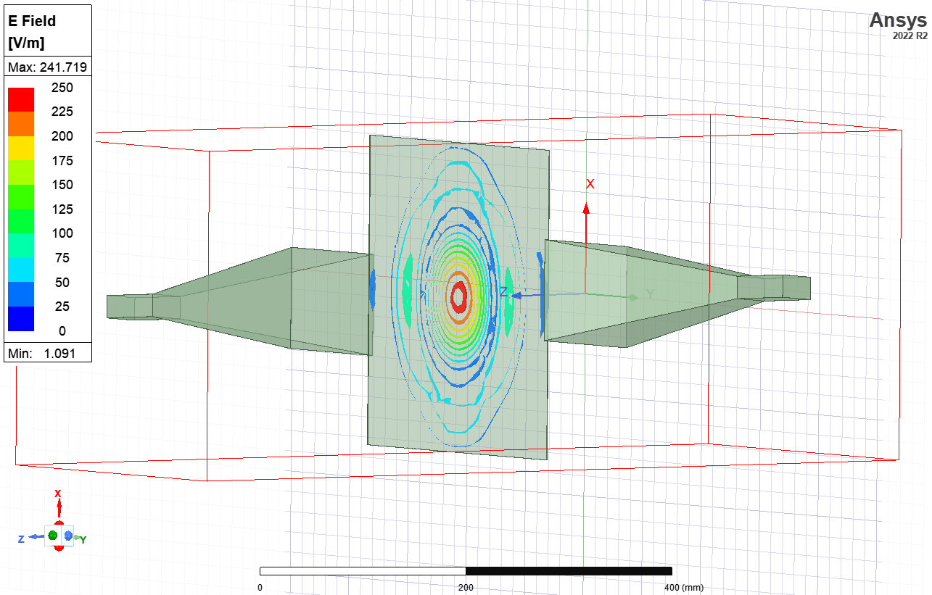
A Teflon Plane Between 2 Horn Antennas

Slide 22
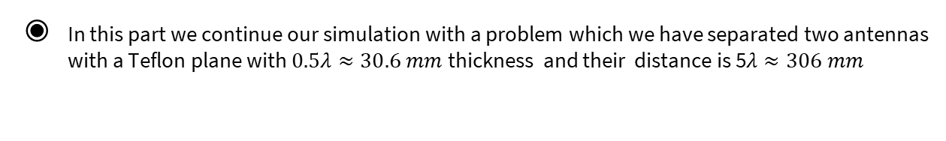
A Teflon Plane Between 2 Horn Antennas
In this part we continue our simulation with a problem which we have separated two antennas with a Teflon plane with $0.5λ≈30.6 mm$ thickness and their distance is 5$λ≈306 mm$

Slide 23
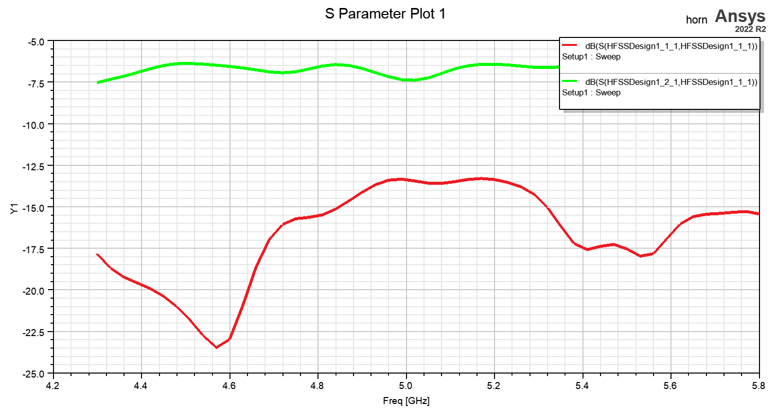
A Teflon Plane Between 2 Horn Antennas

Slide 24
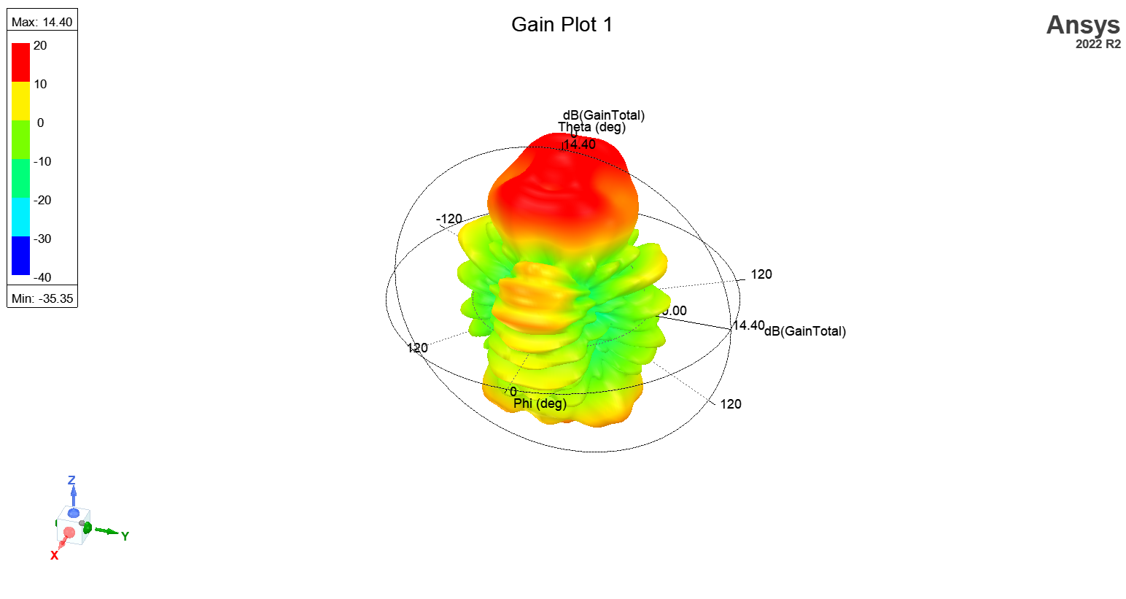
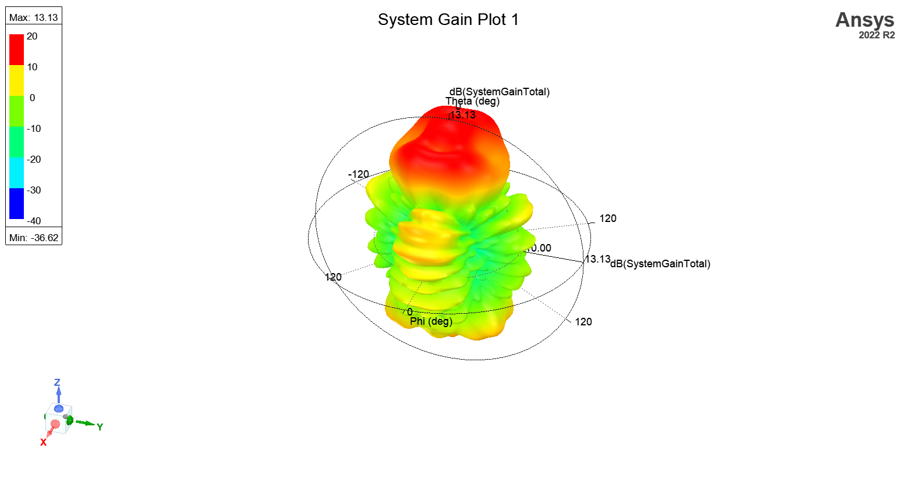
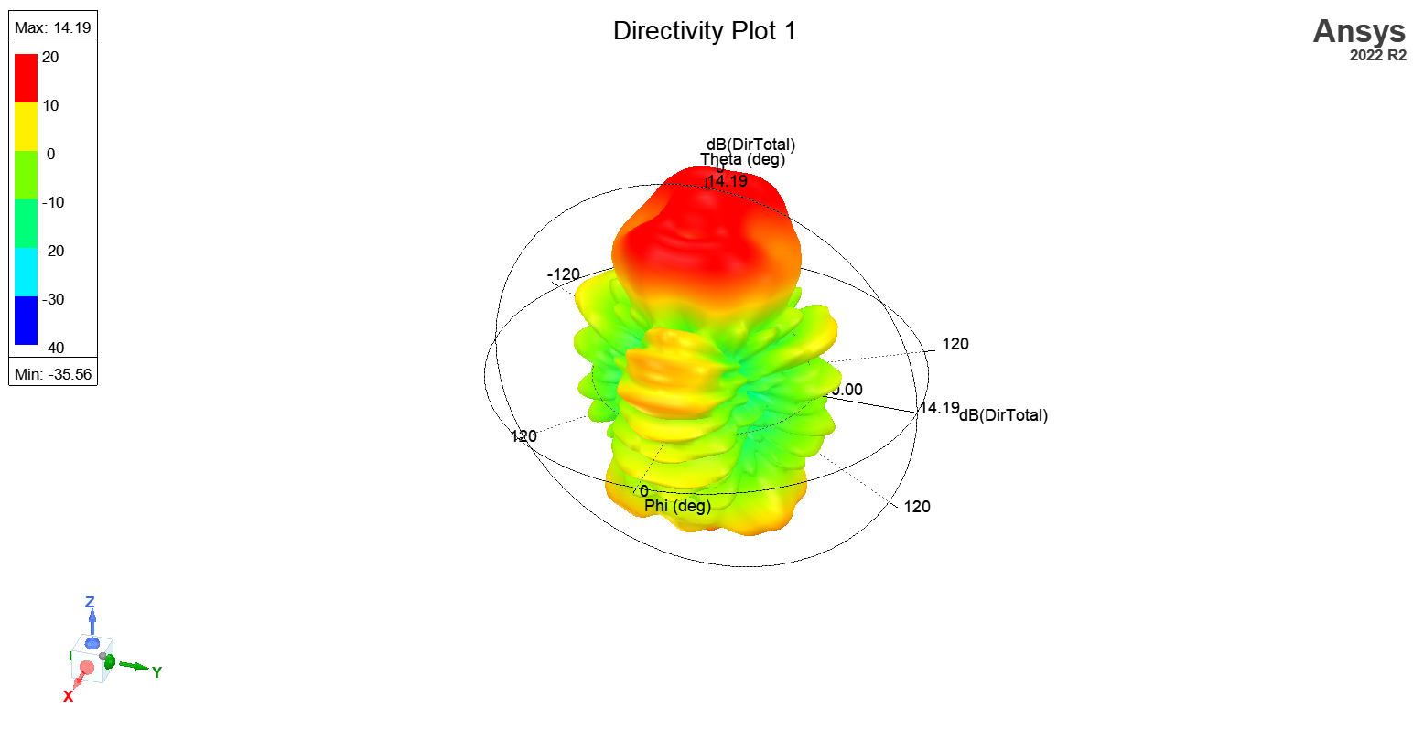
A Teflon Plane Between 2 Horn Antennas

Slide 25
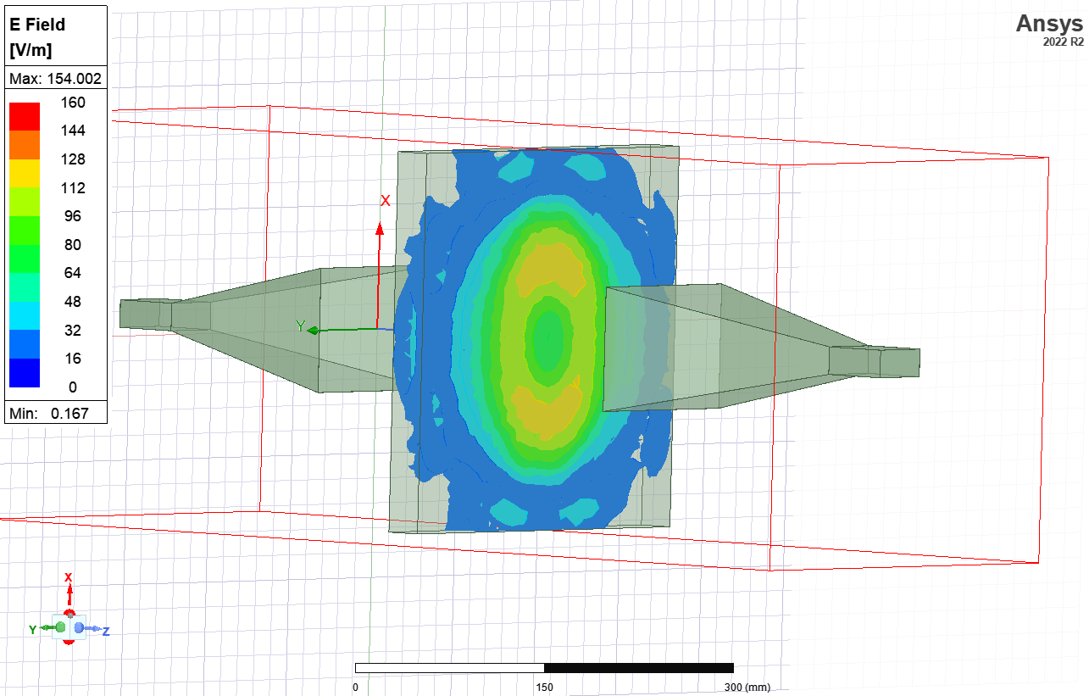
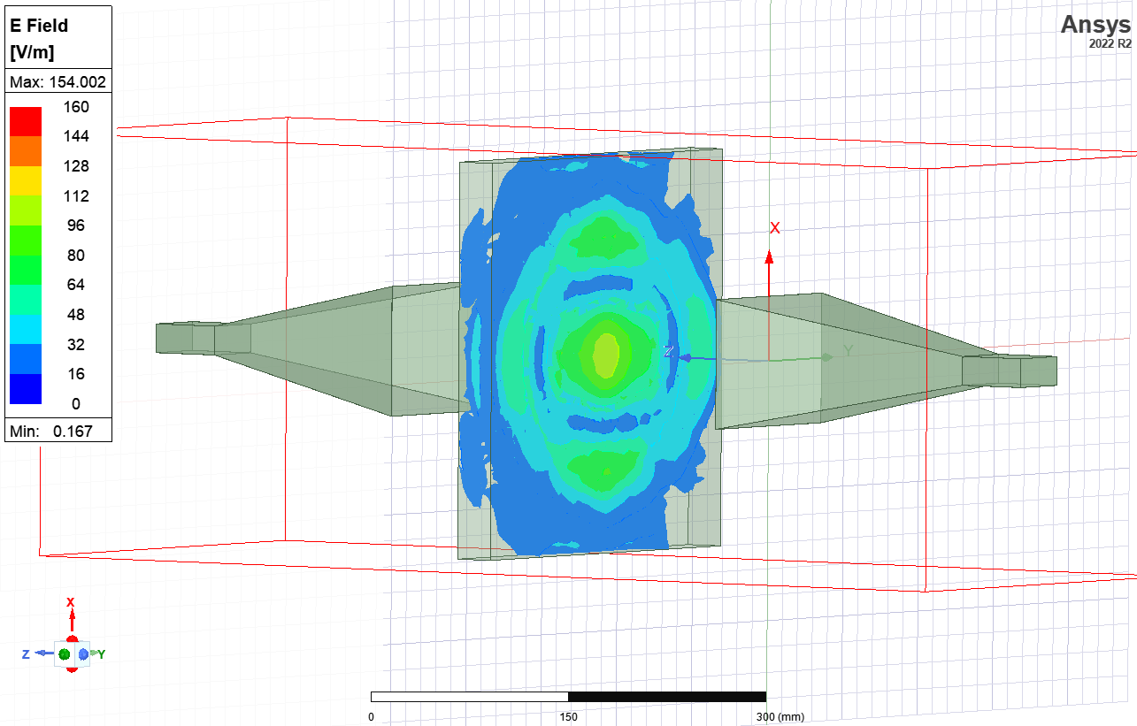
A Teflon Plane Between 2 Horn Antennas

Slide 26
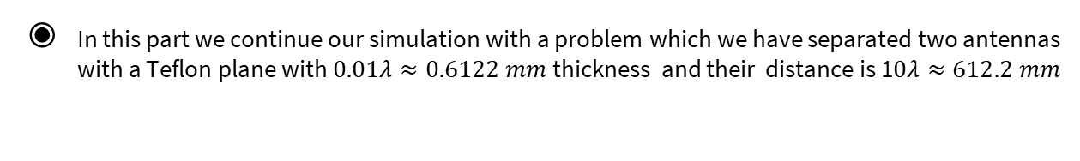
A Teflon Plane Between 2 Horn Antennas
In this part we continue our simulation with a problem which we have separated two antennas with a Teflon plane with $0.01λ≈0.6122 mm$ thickness and their distance is 1$0λ≈612.2 mm$

Slide 27
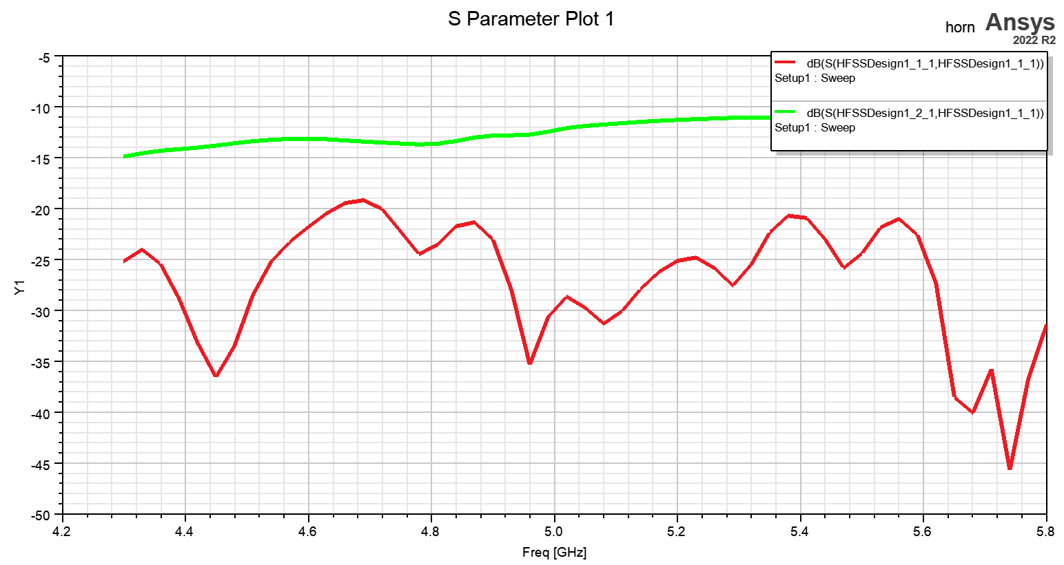
A Teflon Plane Between 2 Horn Antennas

Slide 28
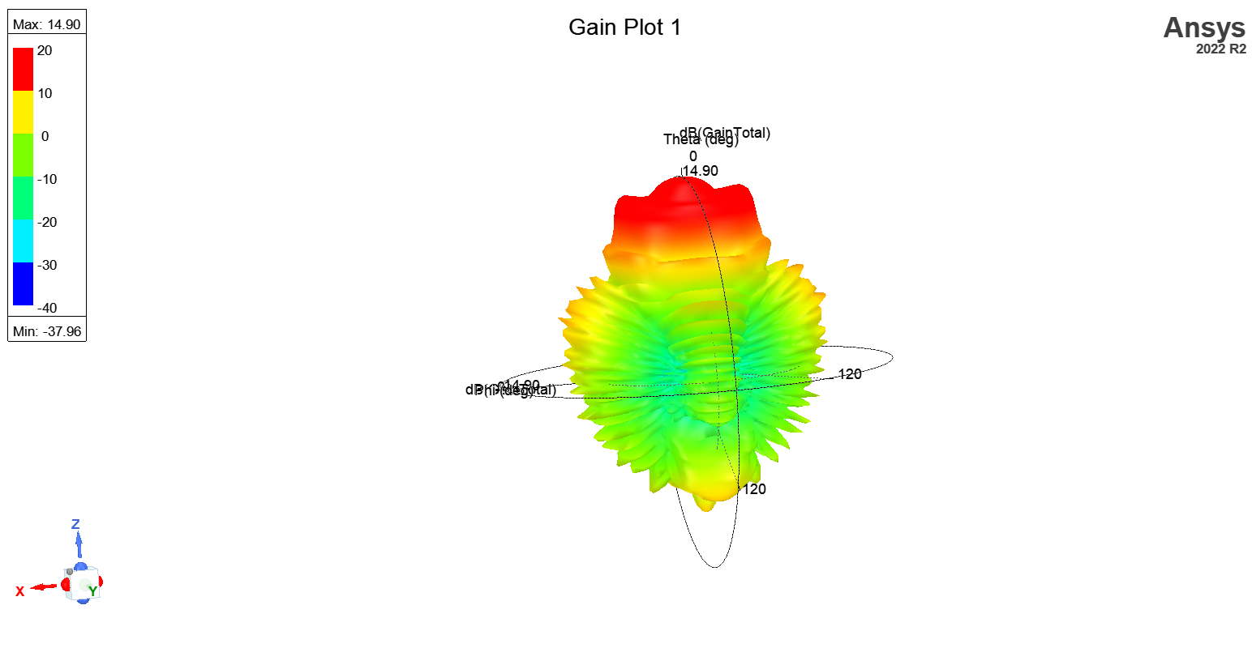
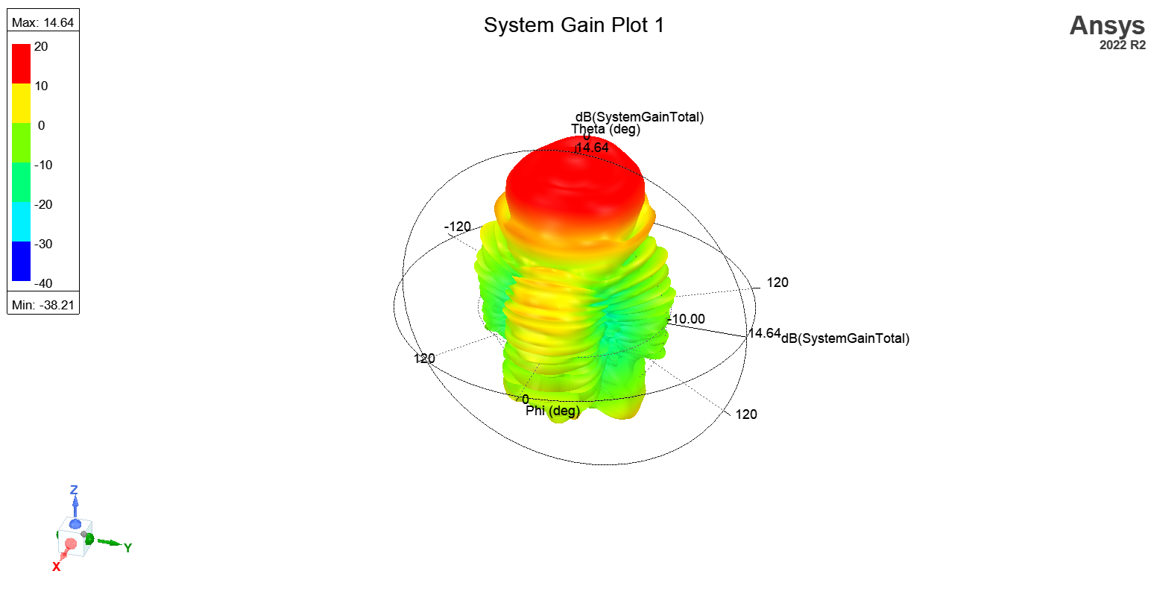
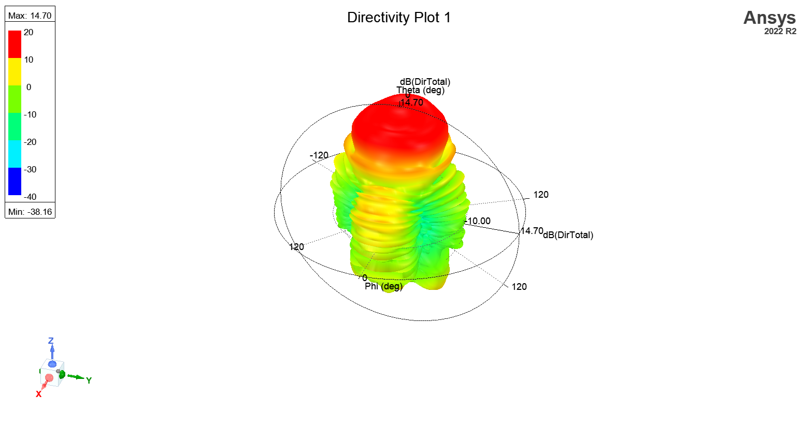
A Teflon Plane Between 2 Horn Antennas

Slide 29
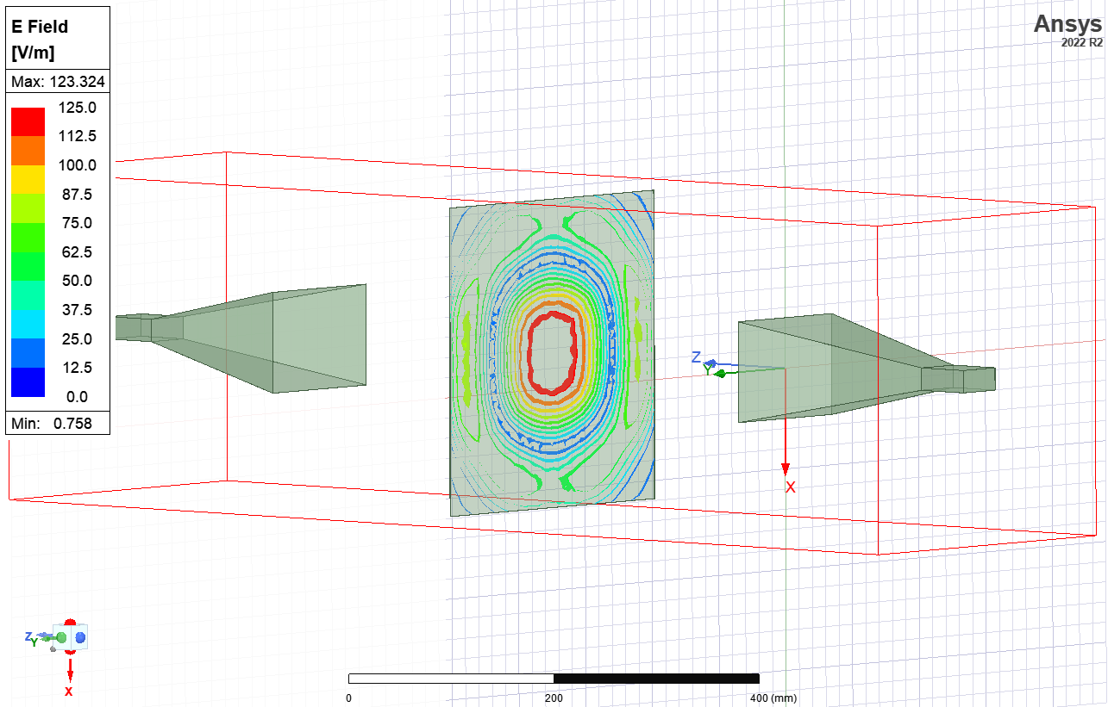
A Teflon Plane Between 2 Horn Antennas

Slide 30
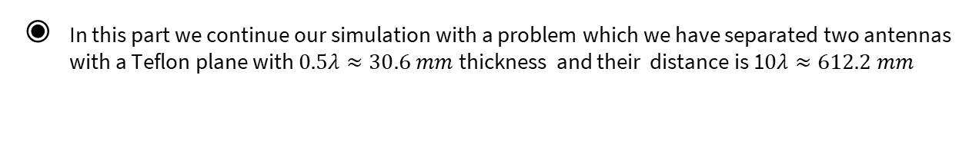
A Teflon Plane Between 2 Horn Antennas
In this part we continue our simulation with a problem which we have separated two antennas with a Teflon plane with $0.5λ≈30.6 mm$ thickness and their distance is 1$0λ≈612.2 mm$

Slide 31
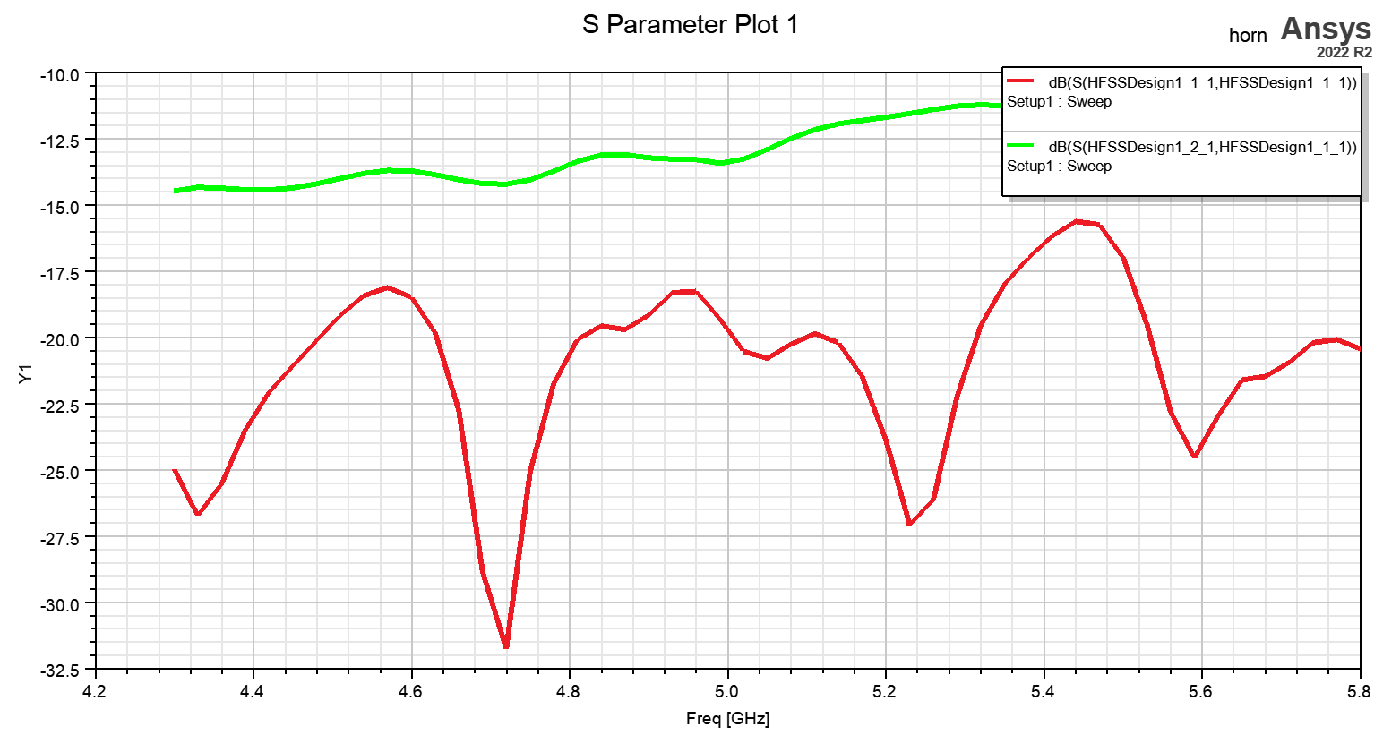
A Teflon Plane Between 2 Horn Antennas

Slide 32
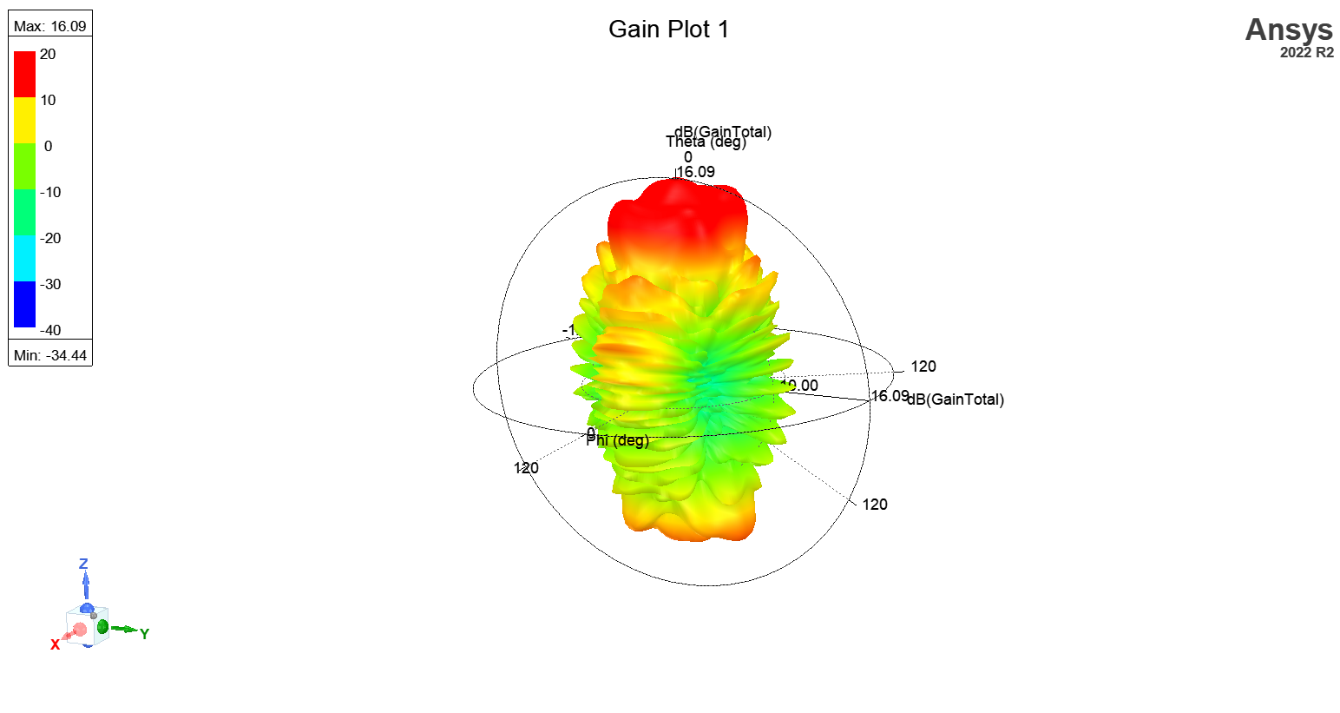
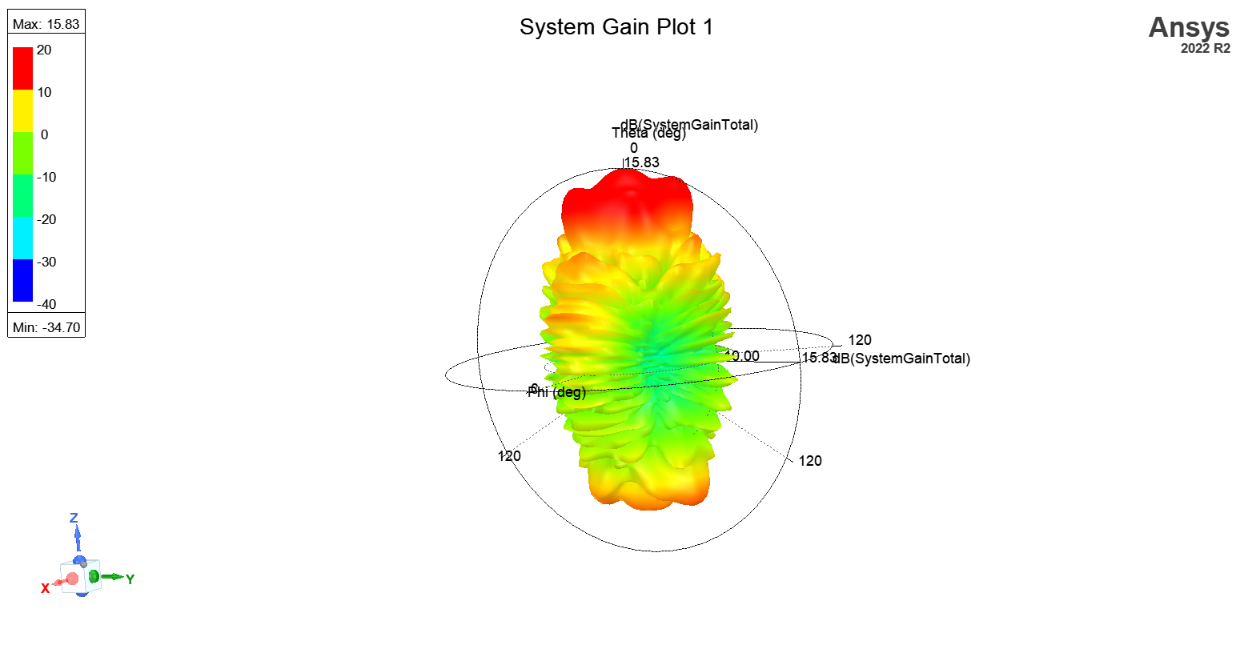

A Teflon Plane Between 2 Horn Antennas

Slide 33


A Teflon Plane Between 2 Horn Antennas

Slide 34

A Teflon Plane Between 2 Horn Antennas
S-parameter: Reflection and Absorption Trends
Higher $S_{11}$ indicates increased reflection
Decrease in $S_{12}$ indicates less absorption with increasing distance
Both S-parameter values exhibit significant drops.
Field Distribution: Thickness and Distance Effects
Thicker Teflon sheet results in more scattered field but lower intensity.
Increasing distance leads to more scattered field resembling the first experiment.
The fourth experiment shows field scattering and variations at the ends of the Teflon sheet
System Efficiency: Consistency in Overall Performance

Slide 35
THANKS!
Any questions?
You can find me at
@alireza_javid01 / Alirezajavid.2001@gmail.com

